Slide 1


Strategic Technologies & Business Enablement
Architecting competitive advantage through foundational technologies, multi-tech integration, adoption lifecycles, and Zero Trust security frameworks.
LO1: Enablers
LO2: Architecture
LO3: Diffusion
LO4: Zero Trust
Cloud, AI, IoT & Blockchain
Multi-Tech Integration
Rogers' Adoption Model
Cybersecurity & Risk

Slide 2


Lesson Agenda & Schedule Breakdown
00:00 - 00:15
Session Opening & Unit Overview
Introduction to LU5 concepts, business enablement goals, and learning expectations.
00:15 - 00:55
LO1: Foundational Enablers & Enterprise Operations
Lecture on Cloud, AI, IoT & Blockchain (25m) + Activity 1: Enabler Matrix Audit (15m)
00:55 - 01:35
LO2: Multi-Technology Architectures
Operational bottlenecks in logistics & data (25m) + Activity 2: Architecture Blueprinting (15m)
01:35 - 01:50
Networking & Refreshment Break
Rest break to refresh before adoption lifecycles and cybersecurity modules.
01:50 - 02:30
LO3: Rogers' Diffusion of Innovation Framework
Adoption lifecycles & user segments (25m) + Activity 3: Innovation Mapping Workshop (15m)
02:30 - 03:10
LO4: Zero Trust & Cybersecurity Adoption
Zero Trust principles & risk mitigation (25m) + Activity 4: Security Simulation (15m)
03:10 - 03:15
Unit Synthesis & Q&A Wrap-Up
Key takeaways, inter-LO connections, and final participant Q&A.

Slide 3

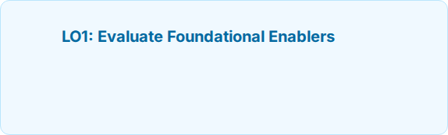
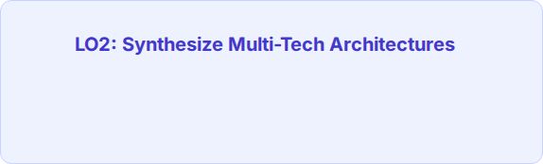


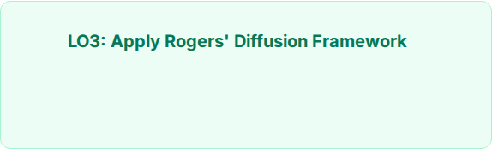
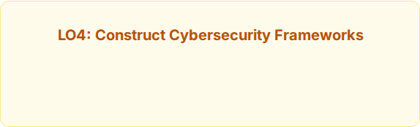


Learning Outcomes (LOs)
Evaluate foundational technological enablers—Cloud Computing, Artificial Intelligence (AI), Internet of Things (IoT), and Blockchain—to streamline enterprise operations and eliminate workflow friction.
Synthesize multi-technology architectures that solve real-world operational bottlenecks across logistics, data security, and real-time executive decision-making.
Apply Rogers' Diffusion of Innovation framework to analyze technological adoption lifecycles, user dynamics, and friction points across enterprise user segments.
Construct robust cybersecurity adoption frameworks that balance risk mitigation, Zero Trust principles, and complex organizational change dynamics.

Slide 4
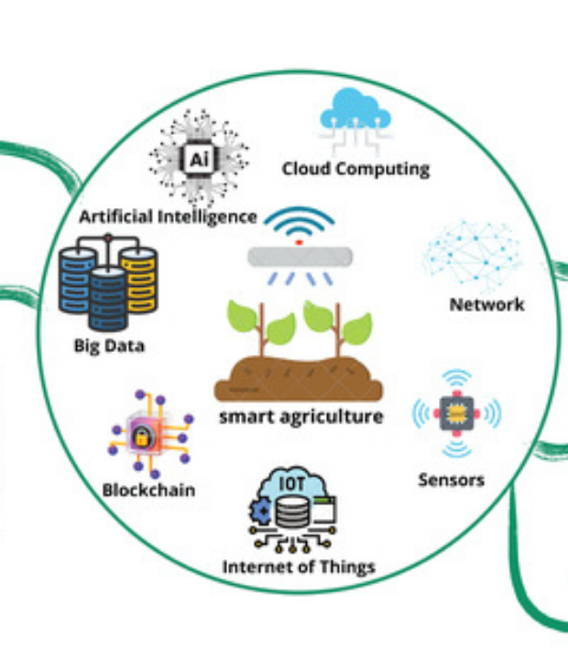




Core Technologies Streamlining Operations
Cloud Computing:
Provides elastic scalability, democratized access to data, and reduced legacy infrastructure costs.
Artificial Intelligence (AI):
Automates repetitive workflows, powers predictive analytics, and drives intelligent decision assistance.
Internet of Things (IoT):
Captures real-time telemetry from physical assets, supply chains, and operational environments.
Blockchain:
Ensures immutable record-keeping, decentralized verification, and smart contract execution.

Slide 5




LO1 Activity: Enabler Impact Assessment
Enterprise Tech Capability & Audit Matrix
Select a target enterprise sector (e.g., Healthcare, Logistics, Banking). Evaluate how integrating Cloud, AI, IoT, and Blockchain directly solves current operational friction points.
Participant Tasks:
Expected Deliverable:
Identify 2 key operational bottlenecks in your chosen sector.
Complete a 2x2 Enabler Assessment Matrix on flipcharts/digital board detailing technology synergy and operational ROI.
Map at least 2 foundational technologies as direct enablers.
Estimate efficiency gain (e.g., speed, accuracy, cost).

Slide 6
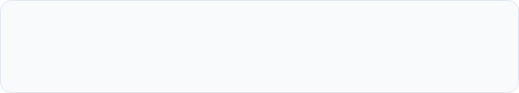
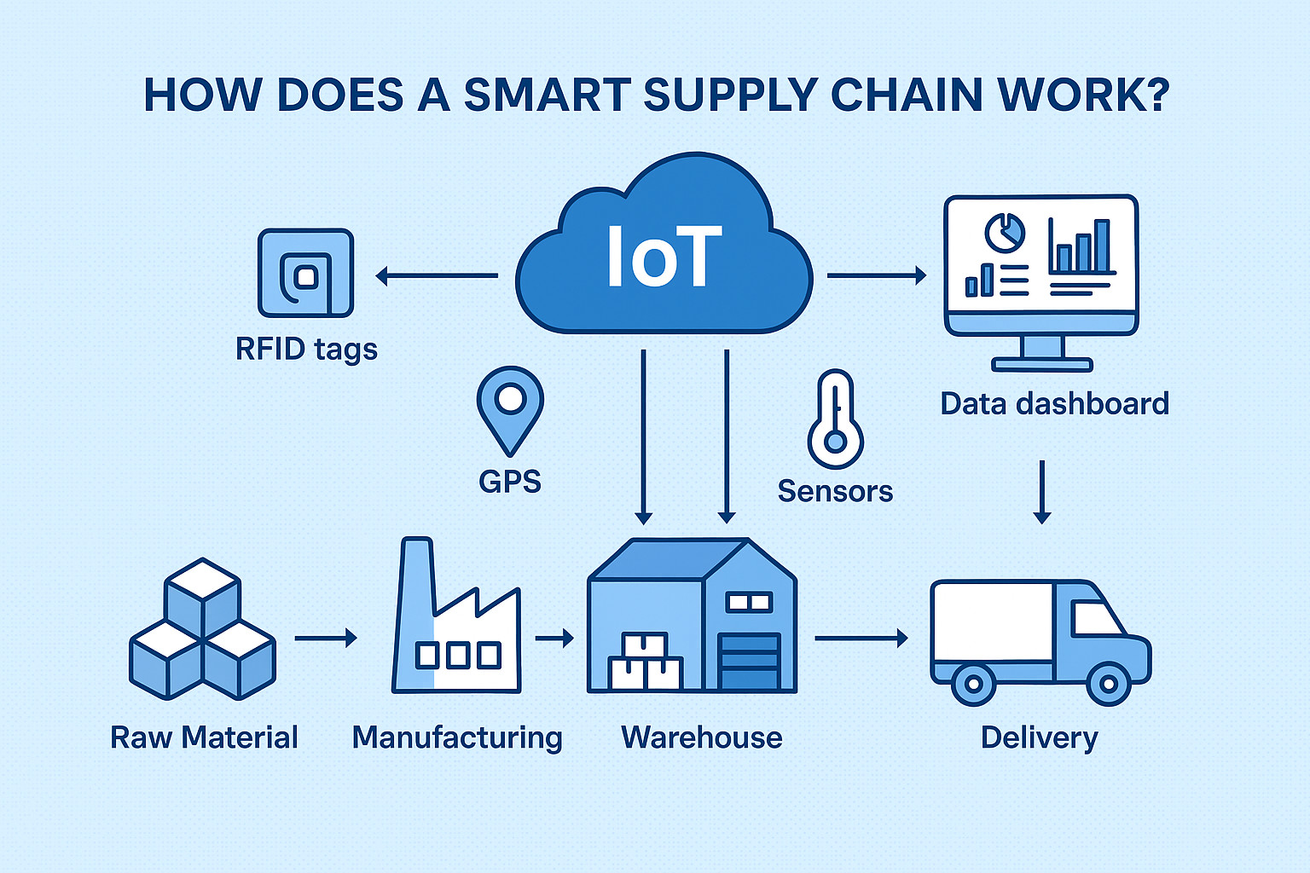
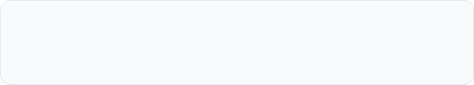
Synthesizing Multi-Technology Stack
Operational Logistics Integration
Combining IoT sensor telemetry with Cloud database storage and AI prediction models to optimize supply chain delivery schedules in real time.
Data Security Layering
Embedding Blockchain ledger verification alongside AI-driven anomaly detection to safeguard sensitive cross-border transaction logs.
Real-time Executive Decision Making
Consolidating disparate multi-cloud and edge feeds into automated executive dashboards powered by prescriptive intelligence algorithms.

Slide 7




LO2 Activity: Multi-Tech Architecture Blueprinting
Case Scenario Challenge
Scenario: Resolving Global Logistics & Data Friction
A global shipping enterprise suffers from delayed container tracking, data tampering risks, and slow decision-making due to fragmented legacy databases.
Step 1: Data Ingestion
Step 2: Trust & Compute
Step 3: AI Intelligence
Design IoT sensor deployment for containers to capture location, temp, and status.
Pipe data into Cloud storage and lock bill-of-lading logs onto Blockchain.
Apply machine learning models to predict customs delays and auto-reroute ships.

Slide 8
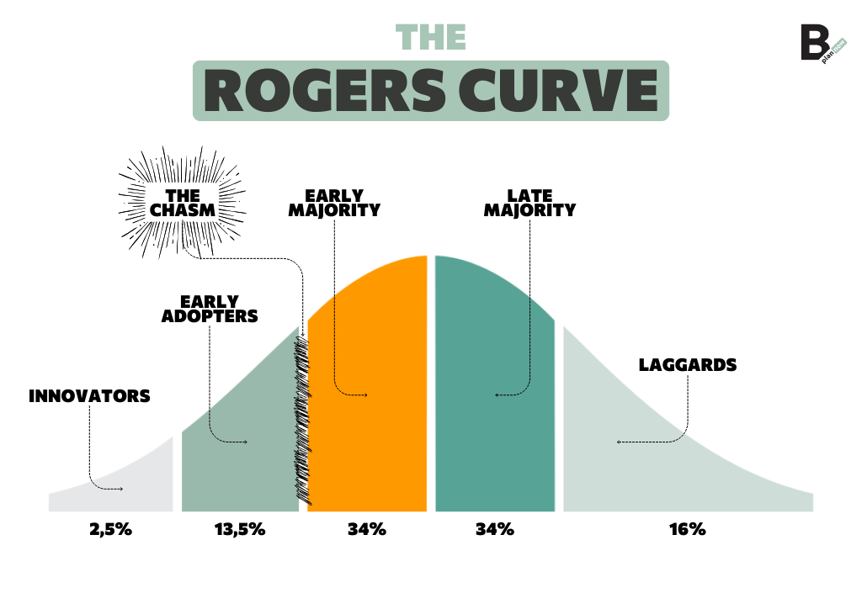
Diffusion of Innovation Framework
Understanding how innovative technologies spread across enterprise user segments is critical for overcoming adoption resistance.
Innovators: Risk-tolerant tech pioneers who champion new tech.
Early Adopters: Visionary leaders seeking strategic edge.
Early Majority: Pragmatists requiring proven ROI & case studies.
Late Majority: Skeptics who adopt only due to market/peer pressure.
Laggards: Traditionalists bound by legacy habits and risk aversion.

Slide 9




LO3 Activity: Tech Adoption & Chasm Mapping
Organizational Change Analysis
Crossing the Tech Adoption "Chasm" in Enterprise
Analyze a target enterprise user base undergoing Enterprise AI or Cloud ERP adoption. Map internal stakeholders to Rogers' 5 user segments and devise targeted adoption nudges.
Stakeholder Categorization
Strategic Enablement Plan
Identify who inside the enterprise acts as the Early Majority vs Late Majority.
Formulate 2 tactics to convert Early Adopters into internal change champions.
Pinpoint the main psychological & technical barriers causing inertia.
Design a training & risk-mitigation incentive for the Late Majority.

Slide 10
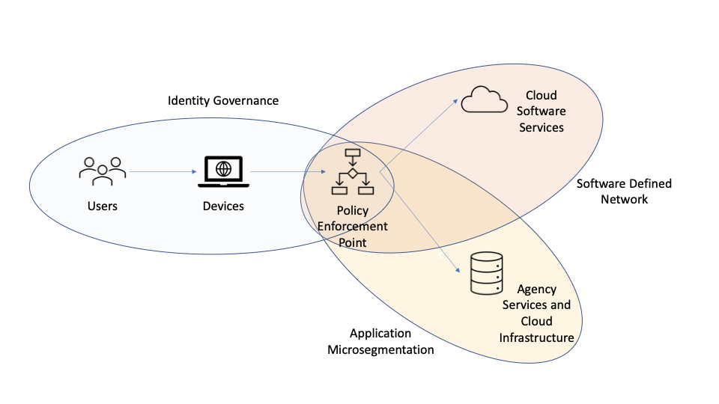



Zero Trust Architecture & Risk Principles
Modern business enablement requires shifting from perimeter-based defense to a strict Never Trust, Always Verify security stance.
Zero trust cybersecurity shield network infrastructure security
1. Explicit Verification
Always authenticate and authorize based on all available data points (user identity, location, device health).
2. Least Privilege Access
Limit user access with Just-In-Time (JIT) and Just-Enough-Access (JEA) policies to safeguard core assets.
3. Assume Breach
Minimize blast radius by segmenting networks, encrypting end-to-end data, and utilizing real-time AI threat analytics.

Slide 11




LO4 Activity: Zero Trust Adoption Simulation
Strategy & Change Dynamics
Balancing Zero Trust Controls & User Experience
Strict security policies often create user friction and push staff toward unauthorized "Shadow IT". How do you balance risk mitigation with business productivity?
Risk Analysis
Policy Design
Change Management
Identify 3 security vulnerabilities caused by rapid Cloud/IoT adoption in mobile work environments.
Formulate dynamic MFA and Passwordless policies that secure devices without frustrating employees.
Outline a rollout campaign to educate staff and overcome organizational pushback against Zero Trust.

Slide 12




Summary & Synthesis
LU5 Strategic Synthesis
Key Takeaways
Technology enablers (Cloud, AI, IoT, Blockchain) deliver exponential value when synthesized into multi-tech architectures.
Rogers' Diffusion Framework provides the strategic lens needed to bridge technical design with human adoption.
Questions & Discussion
Zero Trust security must act as an enabler—balancing risk mitigation with seamless user experience.
Thank you for participating! Open floor for participant questions, scenario reviews, and module feedback.

Slide 13




Image Sources
https://www.mdpi.com/sensors/sensors-25-02147/article_deploy/html/images/sensors-25-02147-g004-550.jpg
Source: www.mdpi.com
https://iotdunia.com/wp-content/uploads/2019/09/working-of-a-smart-supply-chain.jpg
Source: iotdunia.com
https://b-plannow.com/wp-content/uploads/2025/02/The-Rogers-curve-diffusion-of-innovation.png
Source: b-plannow.com
https://lh4.googleusercontent.com/A7ka3pFstseL-KtKzoPkr8UflXeLjPobaqCgTPBmiQRyVHEqpwVwB3LknNy0osrYoBeA9LkWuei9s3HcTpKOZJ46Lxjf1pWxQGDvfe9OPrmT67BF2mvTKDZ-8zN7K6hWScHDt-KL
Source: www.actiac.org

